Slide 1
Probability
definition of probability, Complementary events, Axioms,

Slide 2
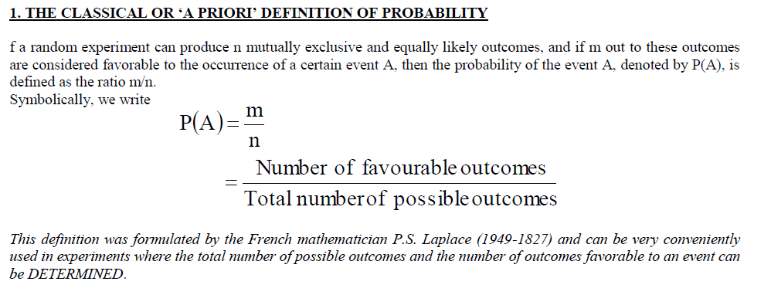

Slide 3
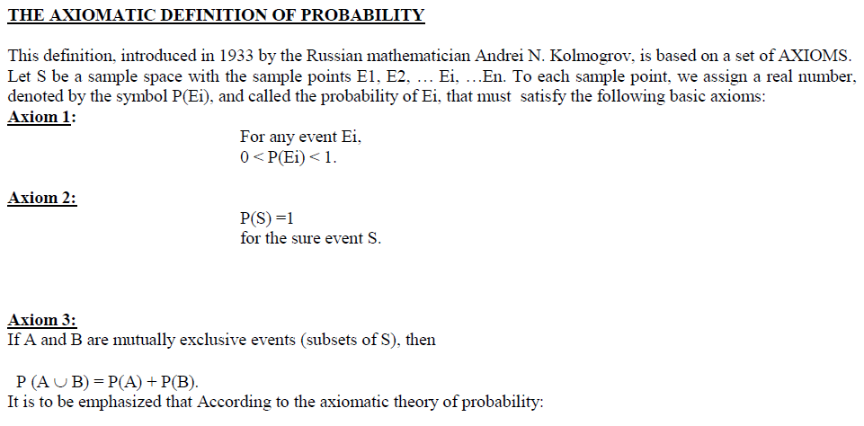

Slide 4



Slide 5
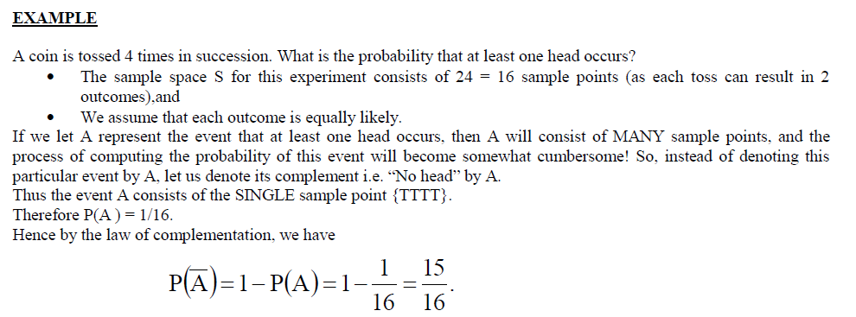

Slide 6



Slide 7
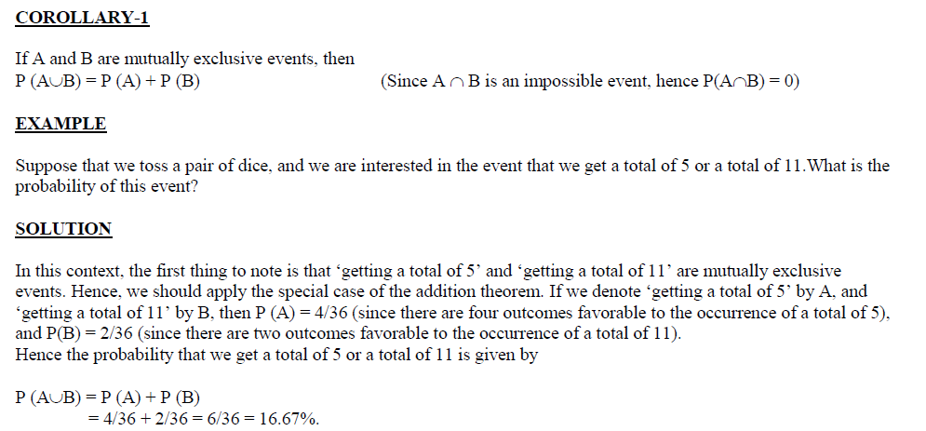

Slide 8


